Slide 1


Valentine’s Day
HOLIDAYS AND FESTIVALS

Slide 2





Read these lovely jokes and try to guess what the answer is.
How did the telephone propose to his girlfriend?
He gave her a ring.
What did the paper clip say to the magnet?
I find you very attractive.
Why would you put candy under your pillow?
To have sweet dreams.

Slide 3
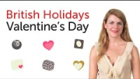
In this video, you'll learn all about Valentine's Day in The United Kingdom and how it's celebrated.
Watch the video and then answer the questions.
1 When is Valentine’s Day?
2 What do people celebrate on Valentine’s Day?
3 Who was Saint Valentine? Why is he important?
4 Aside from Valentine’s Cards, what other gifts people buy to their loved ones on Valentine’s Day?
5 Is Valentine’s Day only for lovers?

Slide 4

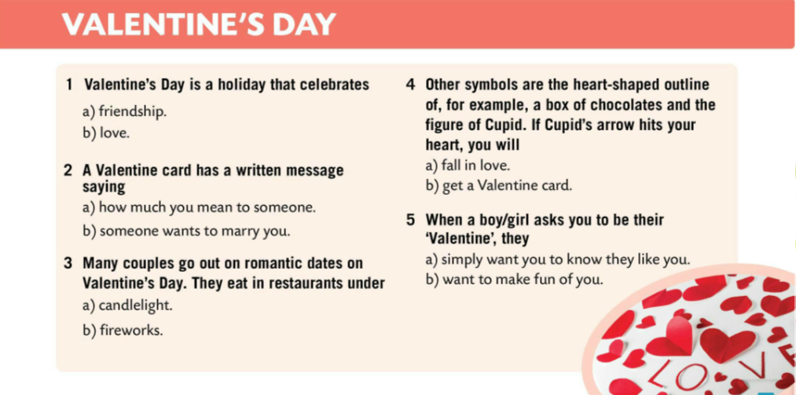

Take the quiz. Circle the correct answer.
Check.
Make a Valentine’s Day card for someone or think of a short poem.
For example:
Roses are red,
Violets are blue.
It’s hard to say it,
but I like you.

Slide 5

Happy Valentine’s Day!

